Slide 1
Defending network based services against state overload attacks
Jinu Kurian (jinuk@student.utdallas.edu)
Kamil Sarac (ksarac@utdallas.edu)
Deptartment of Computer Science
University of Texas at Dallas

Slide 2
Introduction
Value added services in the Internet
  Multicast, QoS, Packet logging etc.
  Introduce state and computational overhead in the network
Multicast
  One of the first value-added services
  Highly efficient for multi-receiver applications
  Routers create multicast trees to forward user data
    Requires added processing and state in the network
    Added overhead can make routers vulnerable to DoS attacks
  Protocol Independent -Source Specific Multicast (PIM-SSM) is the default multicast protocol today
ICCCN 2006
Notes:
Don’t need to write whole sentence

Slide 3


Protocol Independent Multicast
PIM-SSM creates source specific trees from a source S to a receiver R for a group G
    Join(S,G) message propagated from DR(R) to DR(S)
    Routers in the path create forwarding state
      Unicast shortest path interface to S is the incoming interface (iif)
      Interface on which Join was received is the outgoing interface (oif)
Observation
  Join messages are processed by the routers as they arrive
  Routers process the Joins and create forwarding states without any prior knowledge or verification of S or G
Group iif oif
(S,G) d c
Group iif oif
(S,G) f e
R
a
Join(S,G)
Join(S,G)
S
b
c
d
e
f
DR(R)
DR(S)
ICCCN 2006

Slide 4
Problem Description:
State overload attacks
R
Join(S,G)
Attackers
Join(S,G1)
Join(S,G4)
Join(S,G7)
DR(S)
S
Attackers
Join(S,G2)
Join(S,G5)
Join(S,G8)
(S,G1) b a
(S,G2) c a
(S,G3) d a
(S,G1) b a
(S,G2) c a
(S,G3) d a
(S,G4) b a
(S,G5) c a
(S,G6) d a
(S,G1) b a
(S,G2) c a
(S,G3) d a
(S,G4) b a
(S,G5) c a
(S,G6) d a
(S,G7) b a
(S,G8) c a
(S,G9) d a
Attackers
Join(S,G3)
Join(S,G6)
Join(S,G9)
Dropped
ICCCN 2006

Slide 5
Basic solution
Problem: Routers create state without verification of (S,G)
Basic solution: Have an ack message to verify (S,G)
  Create no state during join forwarding
  Create state after ACK is received
Problems with the basic solution:
  What if the attacker generates ACKs instead of Joins ?
  How can the router create the requisite state from an ACK?
Routers need to be able to verify ACKs
  Requisite state can be maintained in control messages
ICCCN 2006

Slide 6

Solution Overview
Join Req
Group iif oif
(S,G) b a
Group iif oif
(S,G) d c
Group iif oif
(S,G) f e
JoinACK(S,G,NDr)
JoinACK(S,G,NDr,Nr1)
DR(R)
R1
R
a
b
c
d
e
f
Join(S,G,NDr)
Join(S,G,NDr,Nr1)
DR(S)
S
a
R
c
DR(R)
MAC_{k}(S,G,a,timer)
MAC_{k}(S,G,c,timer)
Routers in Join forwarding path do not create state
  Append a cryptographic nonce with the requisite state to the Join message
    Nonce contains state and path information
  Nonce accumulates until it reaches DR(S)
DR(S) verifies the validity of (S,G)
  Creates a JoinACK with the accumulated nonce and returns it
  Routers verify nonce to create forwarding states as usual
ICCCN 2006

Slide 7
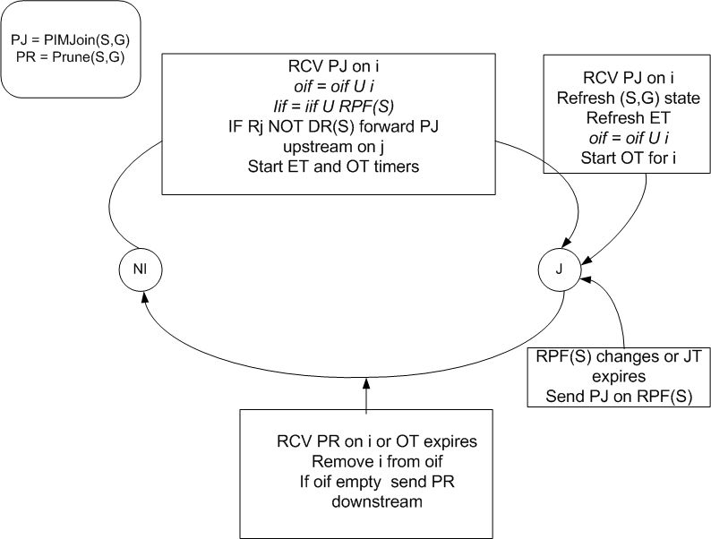
State transition diagram (Unmodified)
ICCCN 2006

Slide 8
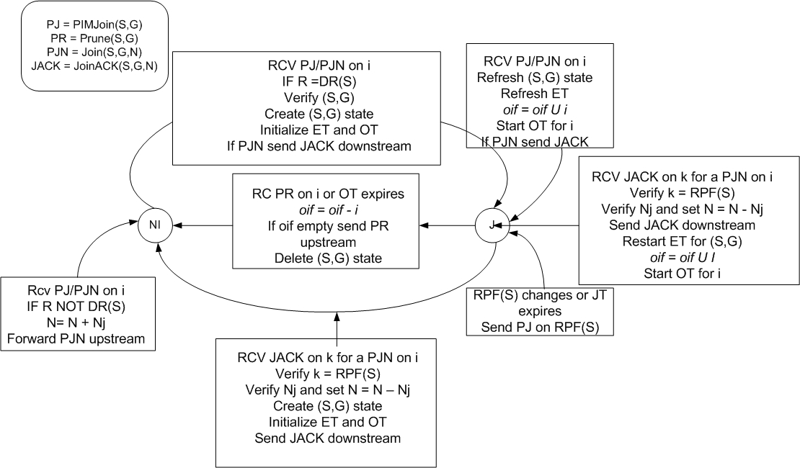
State Transition diagram (Modified)
ICCCN 2006

Slide 9
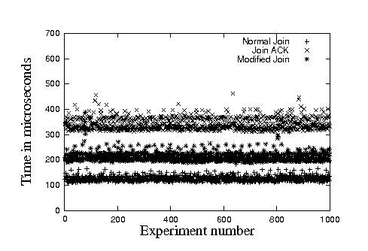
Evaluations: Processing Overhead
We implement the operation of the modified protocol
We measure the time to completion Joins in both cases
It can be seen that the Modified Join and JoinACK apparently impose an increase in 5-6 times overall processing time
ICCCN 2006

Slide 10
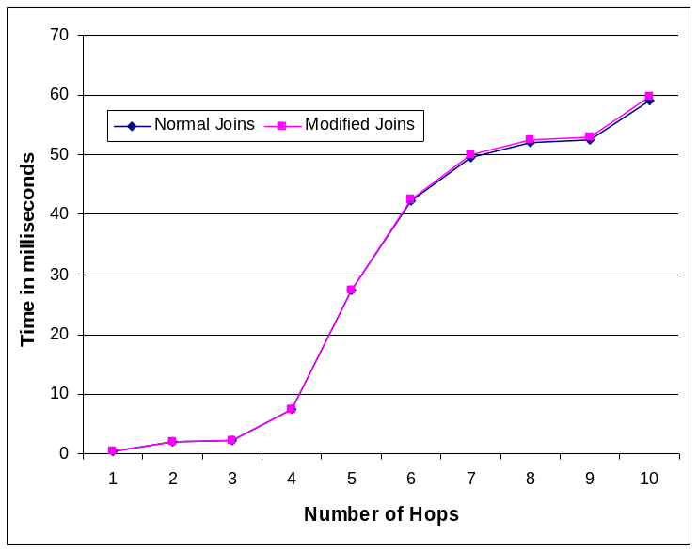
Evaluation: User perceived latency
From an user perspective the overall latency is more important
We see that the user-perceived latency in the modified case follows the unmodified case closely
This is because the processing overhead in the order of microseconds while latency is in milliseconds
ICCCN 2006

Slide 11
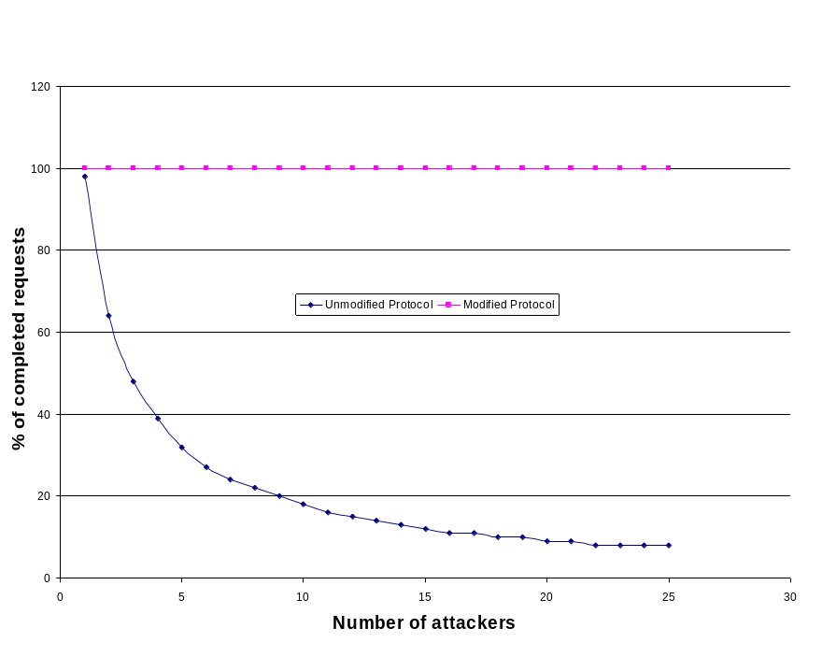
Evaluations: DoS resistance
We measure the percentage of completed requests when the routers in the Join path are under attack
The proposed solution shows virtually no loss while the unmodified protocol shows an exponential decay
ICCCN 2006
Notes:
Summarize Evaluations here

Slide 12


Partial Deployment Scenario
Without a JoinACK from upstream a modified router cannot create state
  Downstream routers can be legacy routers
S
Join(S,G,N)
Join(S,G)
JoinACK(S,G,N)
Group Data
Group Data
N
Group Data
N
Unmodified domain
State Box
Modified domain
ICCCN 2006

Slide 13
Conclusion
State overload attacks can pose a viable threat to the network based services
We examine state overload attacks in the context of multicast as a candidate service
We propose a solution which eliminates these vulnerabilities effectively
The solution proposed is highly effective without noticeable performance loss for the user
It can be configured for incremental deployment
ICCCN 2006

